Slide 1







CROSS-ORIGIN RESOURCE SHARING (CORS)

Slide 2

Content
Introduction CORS?
Why is CORS Necessary?
How CORS Works
Examples of access control scenarios
The HTTP response headers
The HTTP request headers

Slide 3
Introduction CORS?

Slide 4
Cross-Origin Resource Sharing (CORS) is an HTTP-header based mechanism that allows a server to indicate any origins other than its own from which a browser should permit loading resources.
An "origin" in this context is defined by three components:
Protocol: (HTTP or HTTPS)
Domain: (domain) - (example.com)
Port: (port) - (8080)

Slide 5
Why is CORS Necessary?

Slide 6
When developing web applications, you often need to access data from other sources (APIs, external services, etc.). However, to protect users from attacks such as Cross-Site Request Forgery (CSRF), browsers do not allow one website to access resources from another website (this is called the Same-Origin Policy).
CORS allows the server to specify which origins are permitted to access its resources, thus helping to prevent attacks from outside.

Slide 7
Examples of access control scenarios

Slide 8
1. Simple Requests
2. Preflighted requests
3. Requests with credentials
4.Preflight requests and credentials
5. Credentialed requests and wildcards

Slide 9
1. Simple Requests
Simple requests are basic HTTP requests that don’t require a preflight check. These requests follow specific rules:
Allowed Methods: Only GET, HEAD, and POST methods are permitted.
Headers: Only specific headers can be manually set, such as Accept, Accept-Language, Content-Type, Content-Language, Range.
Content-Type Restrictions: The Content-Type can only be one of these types:
application/x-www-form-urlencoded
multipart/form-data
text/plain
No Special Event Listeners: For requests made with XMLHttpRequest, no event listeners should be registered on the upload property.
No ReadableStream: The request should not involve any ReadableStream objects.

Slide 10
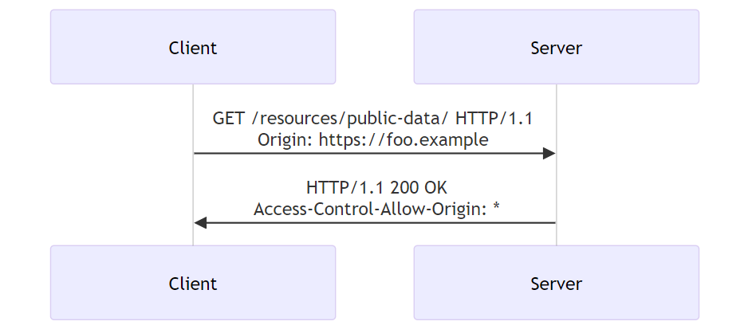
For example: web content at https://foo.example wishes to fetch JSON content from domain https://bar.other

Slide 11
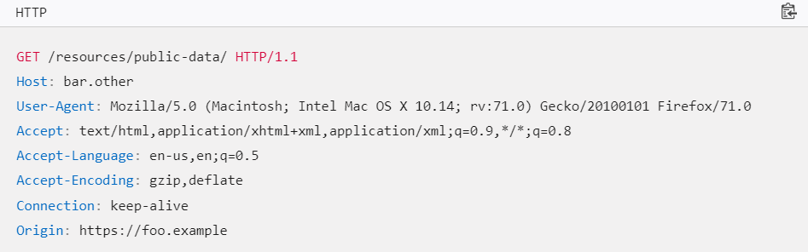
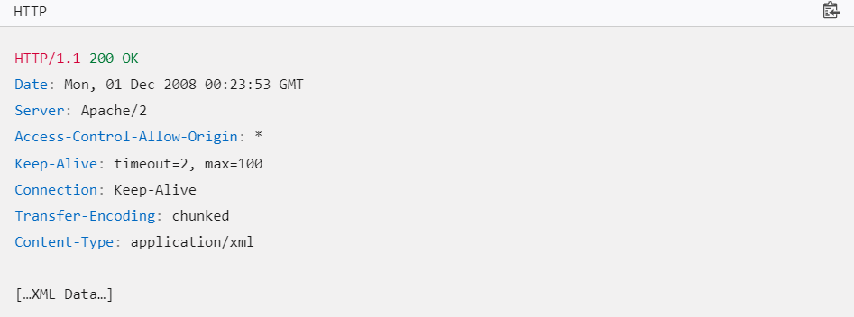
Browsersend to the server:
Server responds:

Slide 12
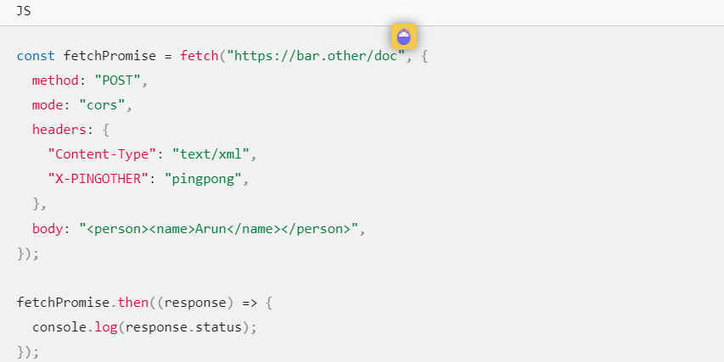
2. Preflighted Requests
Unlike simple requests, for "preflighted" requests the browser first sends an HTTP request using the OPTIONS method to the resource on the other origin, in order to determine if the actual request is safe to send. Such cross-origin requests are preflighted since they may have implications for user data
Example of a request that will be preflighted:

Slide 13
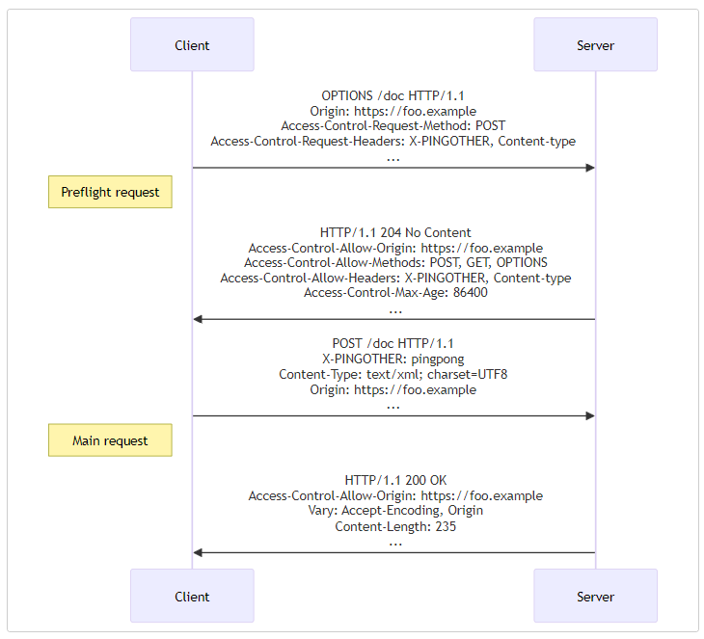

Slide 14
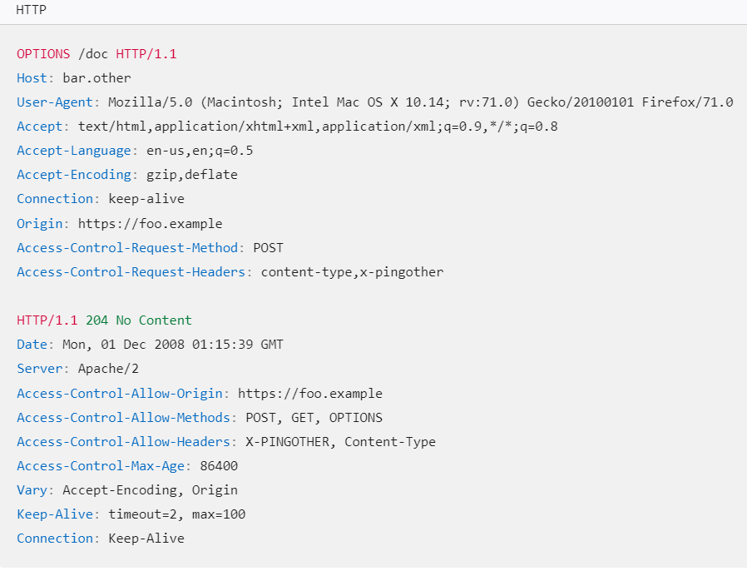

Slide 15
3. Requests with credentials
Requests with credentials: are CORS requests that include cookies or authentication information.
When you make a request to a different domain using fetch() or XMLHttpRequest, by default, the browser will not send cookies or authentication information.
Requests with credentials are necessary in certain scenarios where you need to send cookies or authentication information while calling an API from a different domain. For example, if you are logged into a website, and that website needs to call an API from another server, it requires the ability to identify you using authentication cookies.

Slide 16
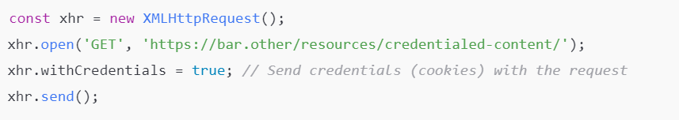
Make requests with credentials:
Using XMLHttpRequest:
To make XMLHttpRequest send cookies or authentication, to set the withCredentials property to true.
Example:

Slide 17
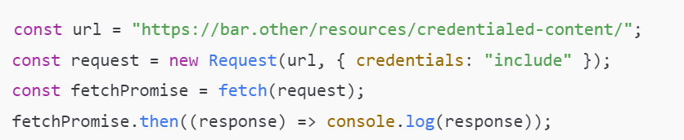
Make requests with credentials:
Using fetch():
To make fetch() send cookies or authentication information, set the credentials option to "include".
By setting credentials: "include", the browser will send cookies or authentication information that has been stored when making the request to https://bar.other

Slide 18
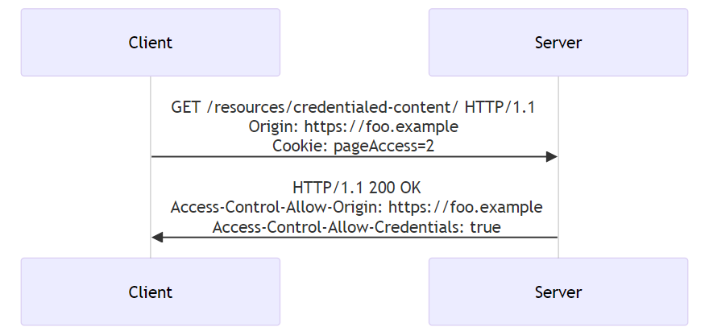

Slide 19
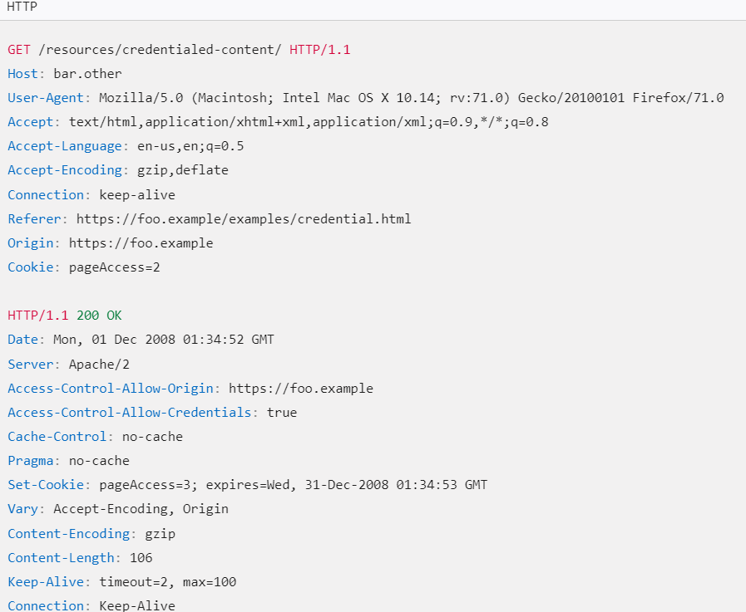

Slide 20
4. Preflight requests and credentials
CORS-preflight requests must never include credentials. The response to a preflight request must specify Access-Control-Allow-Credentials: true to indicate that the actual request can be made with credentials.

Slide 21
4. Credentialed requests and wildcards
When responding to a credentialed request:
The server must not specify the * wildcard for the Access-Control-Allow-Origin response-header value, but must instead specify an explicit origin;
Example: Access-Control-Allow-Origin: https://example.com
The server must not specify the * wildcard for the Access-Control-Allow-Headers response-header value, but must instead specify an explicit list of header names;
Example: Access-Control-Allow-Headers: X-PINGOTHER, Content-Type

Slide 22
IV. Credentialed requests and wildcards
When responding to a credentialed request:
The server must not specify the * wildcard for the Access-Control-Allow-Methods response-header value, but must instead specify an explicit list of method names;
Example: Access-Control-Allow-Methods: POST, GET
The server must not specify the * wildcard for the Access-Control-Expose-Headers response-header value, but must instead specify an explicit list of header names;
Example: Access-Control-Expose-Headers: Content-Encoding, Kuma-Revision

Slide 23
IV. Credentialed requests and wildcards
When responding to a credentialed request:
The server must not specify the * wildcard for the Access-Control-Allow-Methods response-header value, but must instead specify an explicit list of method names;
Example: Access-Control-Allow-Methods: POST, GET
The server must not specify the * wildcard for the Access-Control-Expose-Headers response-header value, but must instead specify an explicit list of header names;
Example: Access-Control-Expose-Headers: Content-Encoding, Kuma-Revision

